Slide 1
Core Methods in Educational Data Mining
EDUC6191 Fall 2022

Slide 2
Diagnostic Metrics -- HW
Any questions about any metrics?
Does anyone want to discuss any of the problems?

Slide 3
Diagnostic Metrics -- HW
What’s a fail-soft intervention?

Slide 4
Diagnostic Metrics -- HW
When do you want to use fail-soft interventions?

Slide 5
Diagnostic Metrics -- HW
When do you not want to use fail-soft interventions?

Slide 6
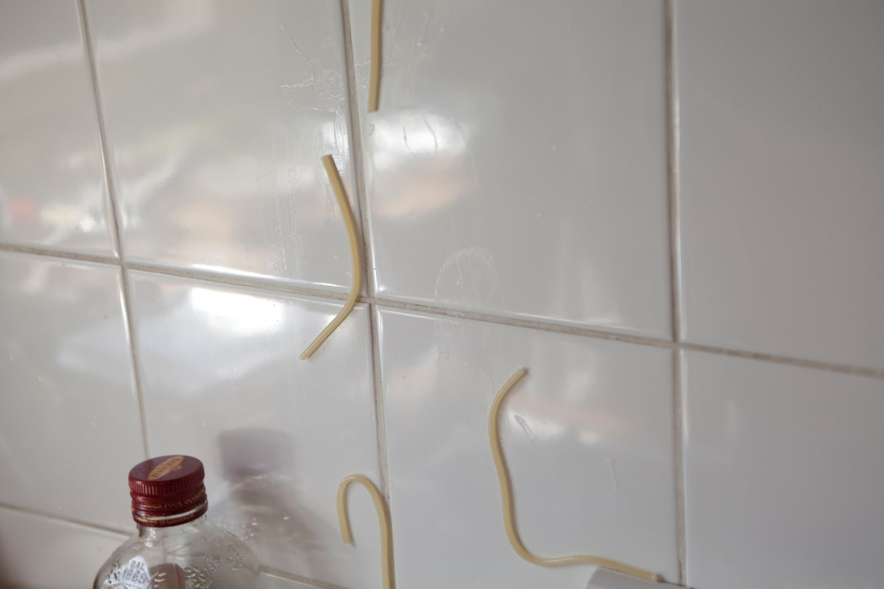
Feature Engineering
Not just throwing spaghetti at the wall and seeing what sticks

Slide 7
Feature Engineering
What is feature engineering?

Slide 8
Feature Engineering (Slater et al., 2020)
“the construction of contextual and relevant features from system log data”

Slide 9
Construct Validity Matters!
Low-quality features will give you low-quality models
Low-quality features = reduced generalizability/more over-fitting
Detailed discussion of this in the Sao Pedro paper

Slide 10
What’s a good feature?
A feature that is potentially meaningfully linked to the construct you want to identify

Slide 11
Baker’s feature engineering process
Brainstorming features
Deciding what features to create
Creating the features
Studying the impact of features on model goodness
Iterating on features if useful
Go to 3 (or 1)

Slide 12
Post to the chat: What’s useful and why?
Brainstorming features
Deciding what features to create
Creating the features
Studying the impact of features on model goodness
Iterating on features if useful
Go to 3 (or 1)

Slide 13
Post to the chat: What’s missing?
Brainstorming features
Deciding what features to create
Creating the features
Studying the impact of features on model goodness
Iterating on features if useful
Go to 3 (or 1)

Slide 14
How else could it be improved?

Slide 15
IDEO tips for Brainstorming
1. Defer judgment
2. Encourage wild ideas
3. Build on the ideas of others
4. Stay focused on the topic
5. One conversation at a time
6. Be visual
7. Go for quantity
http://www.openideo.com/fieldnotes/openideo-team-notes/seven-tips-on-better-brainstorming

Slide 16
Post to the chat: Any thoughts?
1. Defer judgment
2. Encourage wild ideas
3. Build on the ideas of others
4. Stay focused on the topic
5. One conversation at a time
6. Be visual
7. Go for quantity
http://www.openideo.com/fieldnotes/openideo-team-notes/seven-tips-on-better-brainstorming

Slide 17
Deciding what features to create
Trade-off between the effort to create a feature and how likely it is to be useful
Worth biasing in favor of features that are different than anything else you’ve tried before
Explores a different part of the space

Slide 18
General thoughts about feature engineering?

Slide 19
Automated Feature Generation
What are the advantages of automated feature generation, as compared to feature engineering?
What are the disadvantages?

Slide 20
Automated Feature Selection
What are the advantages of automated feature selection, as compared to having a domain expert decide?
What are the disadvantages?

Slide 21
Outer-loop forward selection
What are the advantages and disadvantages to doing this?

Slide 22
Knowledge Engineering
What is knowledge engineering?

Slide 23
Knowledge Engineering
What is the difference between knowledge engineering and EDM?

Slide 24
Knowledge Engineering
What is the difference between good knowledge engineering and bad knowledge engineering?

Slide 25
Knowledge Engineering
What is the difference between (good) knowledge engineering and EDM?
What are the advantages and disadvantages of each?

Slide 26
How can they be integrated?

Slide 27
Other questions, comments, concerns about textbook?

Slide 28
Let’s look at some features used in real models

Slide 29
Let’s look at some features used in real models
Split into 12 break-out rooms in just a minute
Download list of features
Use list of features for your group number (at very beginning of each page)
Which features (or combinations) can you come up with “just so” stories for why they might predict the construct?
Are there any features that seem utterly irrelevant?

Slide 30
Groups 1 and 2
1: Tell us what your construct is
1,2: Tell us your favorite “just so story” from your features
2,1: Tell us about one feature that looks like junk
Everyone else: you have to give the feature a (chat window) yay or boo

Slide 31
Groups 3 and 4
3: Tell us what your construct is
3,4: Tell us your favorite “just so story” from your features
4,3: Tell us about one feature that looks like junk
Everyone else: you have to give the feature a (chat window) yay or boo

Slide 32
And so on…
5 & 6
7 & 8
9 & 10
11 & 12

Slide 33
Comments? Questions?

Slide 34
Slater et al (2020) paper
Iterative feature engineering

Slide 35
Slater et al (2020) paper
Conduct Feature Engineering
Build Model
Test Model
If model good enough, END
Qualitatively Study Model Errors
Go to 2

Slide 36
Slater et al (2020) caveat
Should test end result on totally new data (which unfortunately, this paper didn’t do)

Slide 37
Slater et al (2020) paper
Questions? Comments?

Slide 38
FCBF: What Variables will be kept? (Cutoff = 0.65)
What variables emerge from this table?
 | G | H | I | J | K | L | Predicted
G |  | .7 | .8 | .8 | .4 | .3 | .72
H |  |  | .8 | .7 | .6 | .5 | .38
I |  |  |  | .8 | .3 | .4 | .82
J |  |  |  |  | .8 | .1 | .75
K |  |  |  |  |  | .5 | .65
L |  |  |  |  |  |  | .42

Slide 39
Next classes
October 6
Network Analysis
Creative: Feature Engineering Due
October 13
Bayesian Knowledge Tracing
Basic: SNA Due
October 20
Association Rule Mining
Basic: BKT Due

Slide 40
The End

